Slide 1
MA3077 Operational Research Lecture 3 - Solving linear programming problems in Matlab
Dr Marco Fasondini

Slide 2
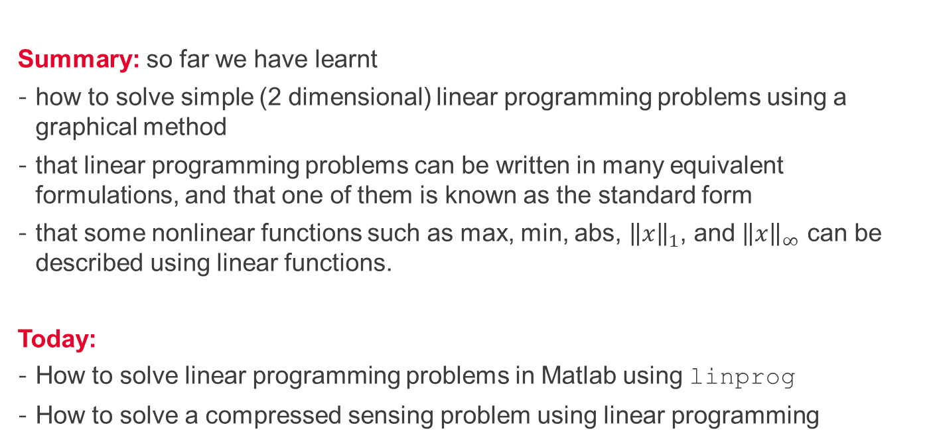
Recapitulation and lecture outline
Summary: so far we have learnt
how to solve simple (2 dimensional) linear programming problems using a graphical method
that linear programming problems can be written in many equivalent formulations, and that one of them is known as the standard form
that some nonlinear functions such as max, min, abs, ${\left\|x\right\|}_{1}$, and ${\left\|x\right\|}_{∞}$ can be described using linear functions.
Today:
How to solve linear programming problems in Matlab using linprog
How to solve a compressed sensing problem using linear programming

Slide 3
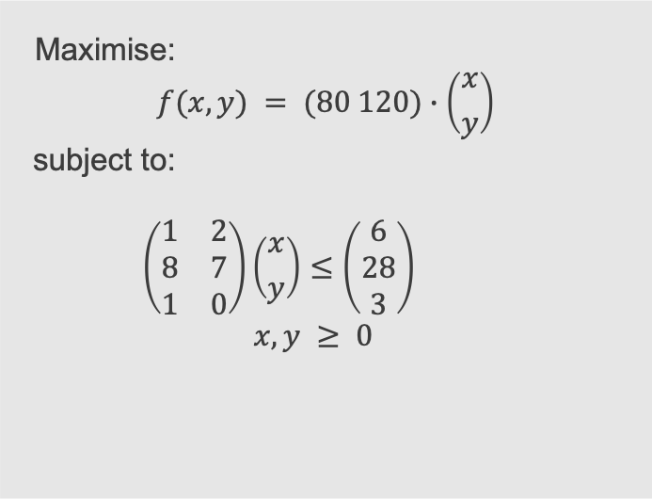
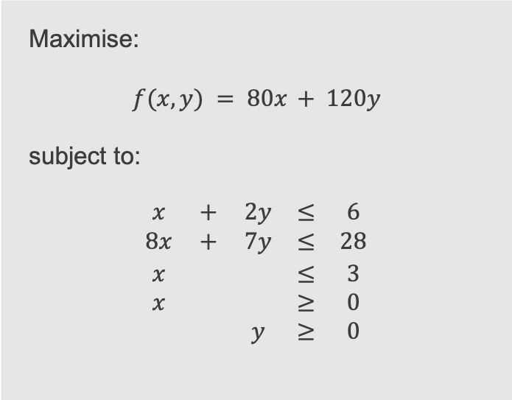
A previous example - formulation
Mathematically, we usually write the problem as follows:
Maximise:
$$f(x,y) = 80x + 120y$$
subject to:
$$\begin{matrix}x & + & 2y & ≤ & 6 \\ 8x & + & 7y & ≤ & 28 \\ x & & & ≤ & 3 \\ x & & & ≥ & 0 \\ & & y & ≥ & 0\end{matrix}$$
Maximise:
$$f(x,y) = (80 120)∙\left({x \atop y}\right)$$
subject to:
$$\left(\begin{matrix}1 & 2 \\ 8 & 7 \\ 1 & 0\end{matrix}\right)\left({x \atop y}\right)≤\left(\begin{matrix}6 \\ 28 \\ 3\end{matrix}\right)$$
$$x,y ≥ 0$$
This is a linear programming problem because both the objective and the constraints can be expressed with linear functions.

Slide 4
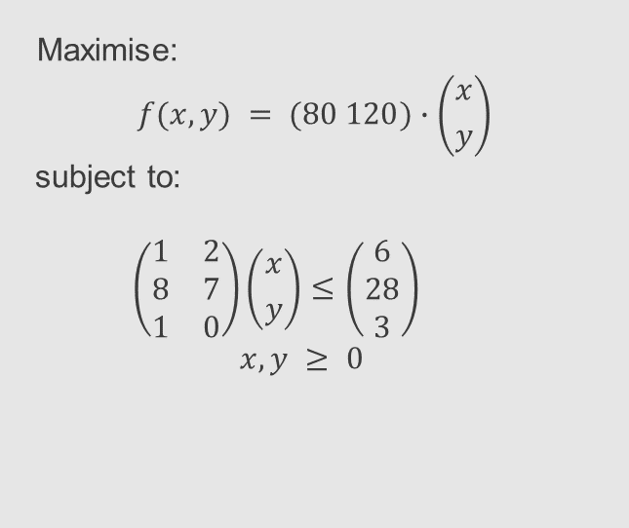
A previous example – graphical solution
Maximise:
$$f(x,y) = (80 120)∙\left({x \atop y}\right)$$
subject to:
$$\left(\begin{matrix}1 & 2 \\ 8 & 7 \\ 1 & 0\end{matrix}\right)\left({x \atop y}\right)≤\left(\begin{matrix}6 \\ 28 \\ 3\end{matrix}\right)$$
$$x,y ≥ 0$$

Slide 5
An example – solve in Matlab with linprog (see Matlab's documentation)
% set the problem specs
f = -1*[80;120]; % objective function to minimise
A = [1 2; 8 7; 1 0]; % inequality constraints matrix
b = [6 28 3]; % inequality constraints rhs
Aeq = []; % equality constraints matrix
beq = []; % inequality constraints rhs
lb = zeros(size(f)); % lower bounds
ub = []; % upper bounds
% solve the problem
[x,fval,exitflag,output] = linprog(f,A,b,Aeq,beq,lb,ub);

Slide 6
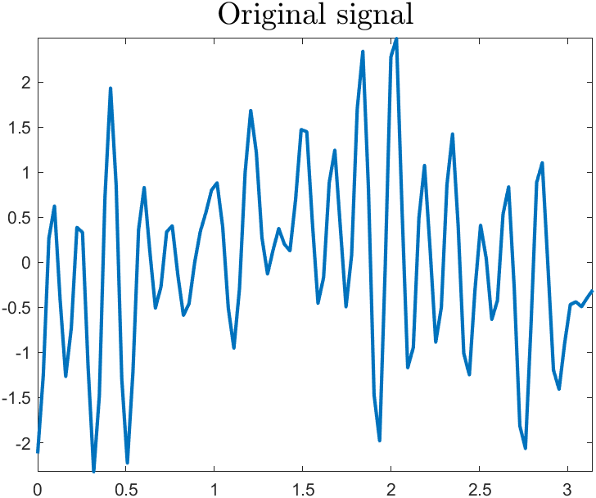
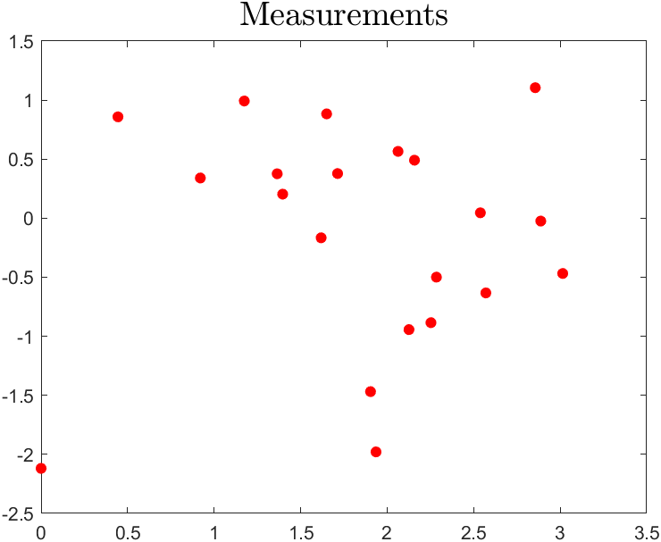
Compressed sensing – an example
Scenario: Your friend is sending you a signal through the aether, but your aether decoder is currently malfunctioning and can only take a discrete number of measurements/samples.
Question: Can you retrieve the signal from these measurements?

Slide 7
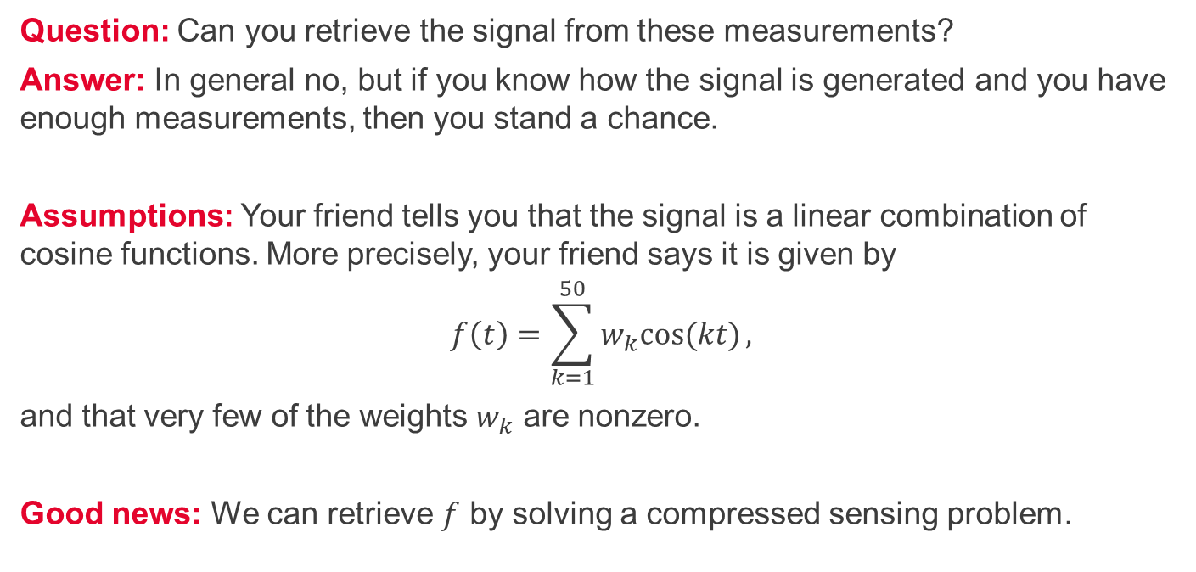
Compressed sensing - questions
Question: Can you retrieve the signal from these measurements?
Answer: In general no, but if you know how the signal is generated and you have enough measurements, then you stand a chance.
Assumptions: Your friend tells you that the signal is a linear combination of cosine functions. More precisely, your friend says it is given by
$$f\left(t\right)=\sum_{k=1}^{50}{w_{k}cos⁡(kt)},$$
and that very few of the weights $w_{k}$ are nonzero.
Good news: We can retrieve $f$ by solving a compressed sensing problem.

Slide 8
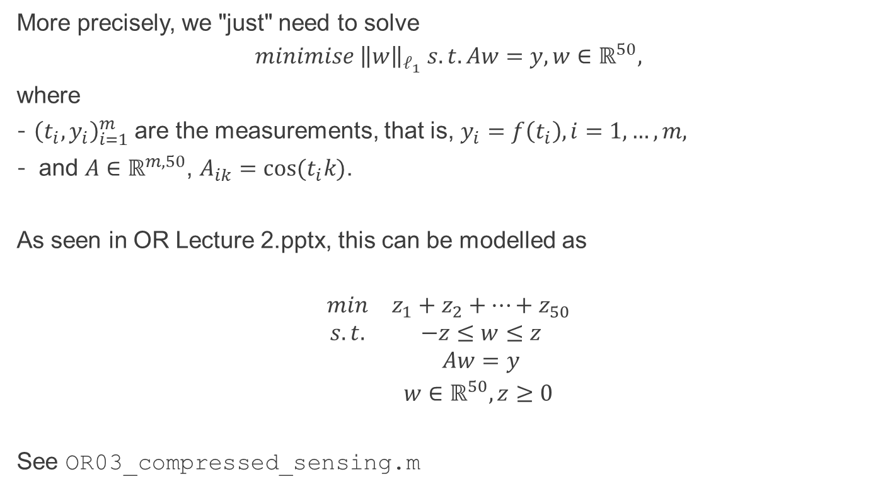
Compressed sensing – mathematical model
More precisely, we "just" need to solve
$$minimise {\left\|w\right\|}_{ℓ_{1}} s.t. Aw=y, w∈ℝ^{50},$$
where
${\left(t_{i},y_{i}\right)}_{i=1}^{m}$are the measurements, that is, $y_{i}=f\left(t_{i}\right), i=1,…, m,$
and $A∈ℝ^{m,50}$, $A_{ik}=cos⁡(t_{i}k)$.
As seen in OR Lecture 2.pptx, this can be modelled as
$$\begin{matrix}min & z_{1}+z_{2}+…+z_{50} \\ s.t. & −z≤w≤z \\ & Aw=y \\ & w∈ℝ^{50}, z≥0 \end{matrix}$$
See OR03_compressed_sensing.m

Slide 9
Summary and self-study
Summary: today we learned
how to solve linear programming problems in Matlab using linprog.
how to tackle a compressed sensing problem via linear programming.
Self-study:
Solve the self-study problems on the last slide of OR Lecture 2.pptx in Matlab using linprog.
In OR03_compressed_sensing.m, experiment with the parameters number of modes, number of nonzero weights, number of measurements. What do you observe?

